Slide 1



Introduction to Bash Scripting
Welcome to the world of Bash scripting! In this guide, we will learn the basics of Bash scripting and explore various concepts like variables, conditional statements, loops, functions, command-line arguments, file operations, and searching in files using grep. So, let's dive in and start our journey to becoming Bash script ninjas!

Slide 2
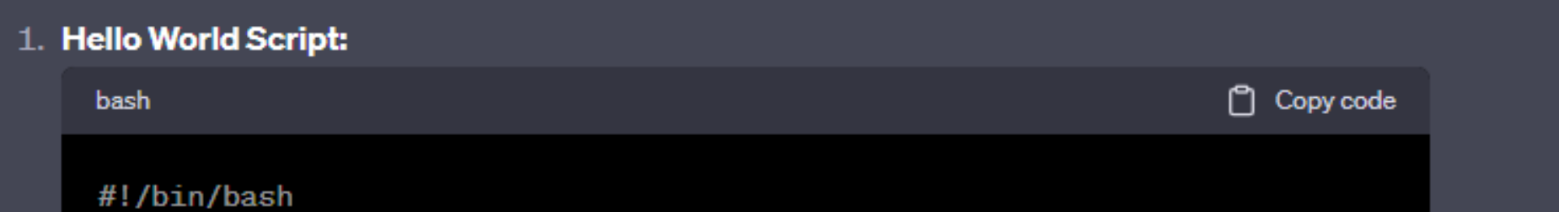
Getting Started with Bash
1
Hello World Script
The very first step is to write a simple "Hello, World!" script. Create a file, for example, hello.sh, make it executable using chmod +x hello.sh and run it using ./hello.sh.
2
Variables and User Input
Learn how to use variables to store values and interact with users by taking their input. Use the read command to get user input and store it in a variable.
3
Conditional Statements
Understand how to write conditional statements using if-else blocks to perform actions based on certain conditions. Get familiar with operators like -ge for greater than or equal to.

Slide 3
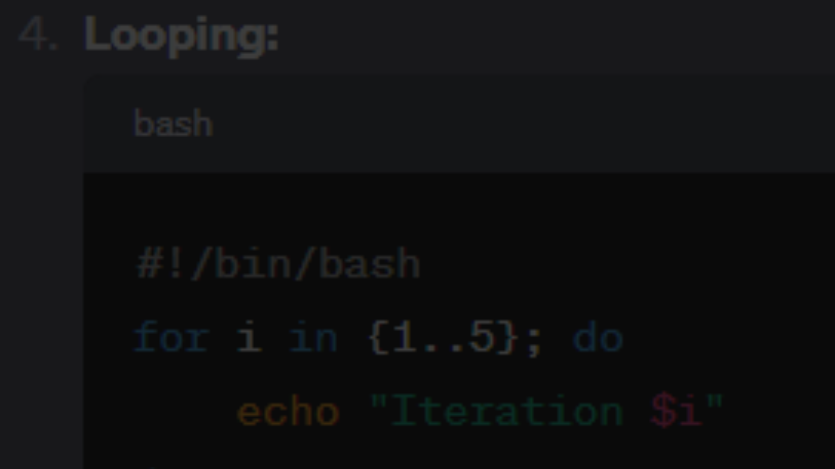
Looping in Bash
For Loop
While Loop
Learn how to use a for loop to iterate over a sequence of values. Iterate a specific number of times or over a range of values using brace expansion.
Explore using a while loop to repeatedly execute a block of code as long as a certain condition is met. Continuously perform actions until a specific condition becomes false.

Slide 4
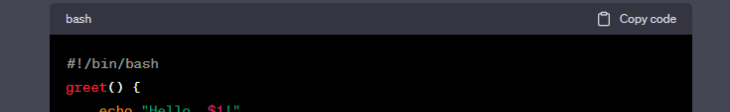
Functions in Bash
1
Creating Functions
Discover how to create functions in Bash to reuse blocks of code. Use the function_name() syntax and pass arguments to functions.
2
Calling Functions
Learn how to call functions by simply using their name followed by parentheses. Pass arguments to functions to perform specific tasks.
3
Returning Values
Understand how to return values from functions using the return statement. Retrieve and utilize the returned values in the script.

Slide 5
Command-Line Arguments
Script Name
Get insights into how to retrieve the name of the script being executed using the special variable $0.
First Argument
Discover a way to capture and utilize the first argument passed to the script using the special variable $1.
Second Argument
Explore how to access the second argument passed to the script and leverage it in your Bash script using the special variable $2.

Slide 6



File Operations in Bash
Checking File Existence
Working with Text Files
Navigating Directories
Dive into various operations you can perform on text files, such as reading, writing, appending, searching, and replacing text, using different commands and redirections.
Gain insights into how to navigate and manipulate directories using commands like cd, ls, pwd, and more. Perform tasks related to file management.
Learn how to check whether a file exists in a directory using the -e flag with the if statement. Take appropriate actions based on the result.

Slide 7
Searching in Files with grep
Basic Search
Advanced Search
Discover how to use the versatile grep command to search for specific text patterns in files. Find lines matching a specific pattern or word.
Explore more advanced options of grep to perform case-insensitive searches, search recursively in directories, specify output formats, and more.

Slide 8
Conclusion
Congratulations! You have learned the fundamentals of Bash scripting. Now, armed with this knowledge, you can automate tasks, create powerful scripts, and enhance your efficiency as a developer. Keep exploring and experimenting with Bash to unlock its full potential. Happy scripting!

